Slide 1
AgriScan: The Plant Doctor
Plant Disease Detection using Deep Learning

Slide 2

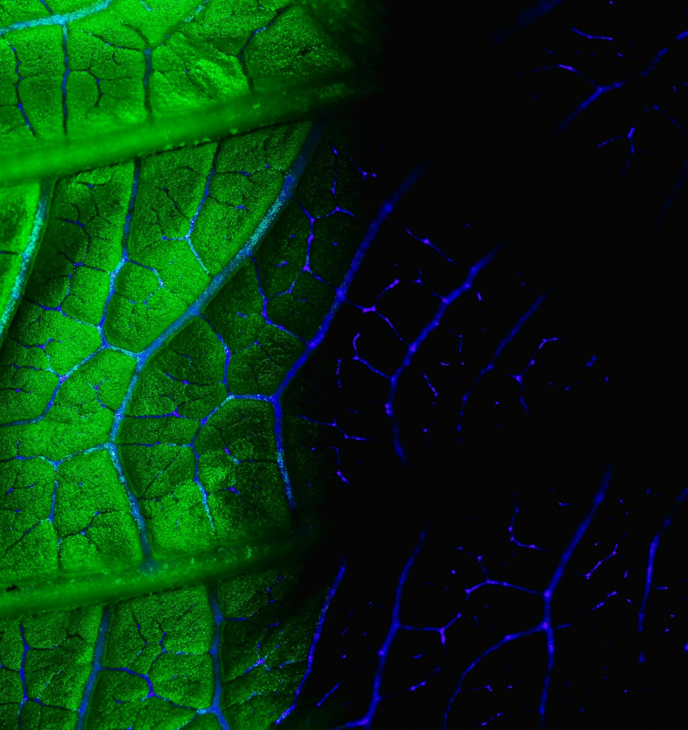
Introduction
Let us explore the potential of Deep Learning in revolutionizing Plant Disease Detection through accurate leaf image analysis. We will discuss the challenges in traditional methods and the opportunities that advanced technology brings to this crucial aspect of agriculture.

Slide 3

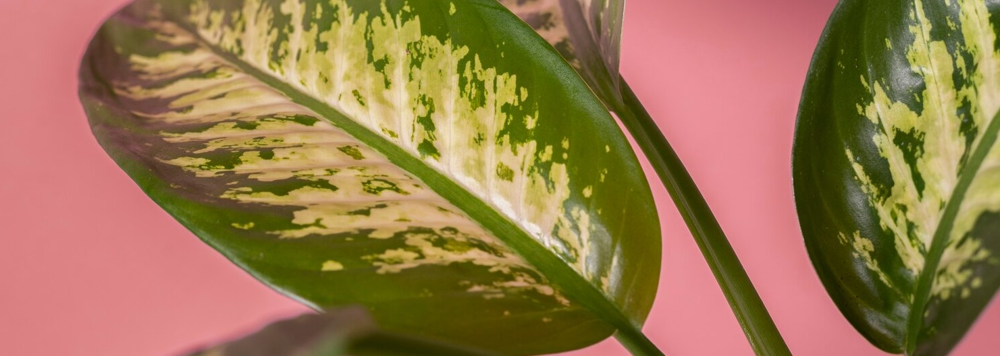
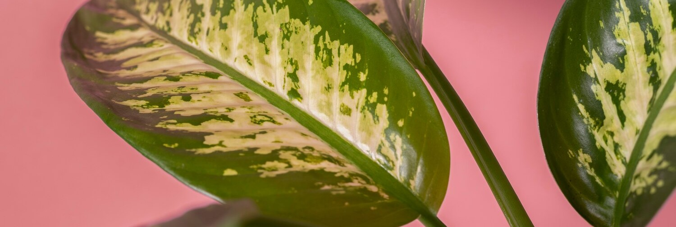
Challenges in Disease Detection
Traditional methods rely on visual inspection Leads to inaccuracies and delays in diagnosis
Manual assessment : labor-intensive and prone to human error
Thus, the need for a more efficient and reliable approach

Slide 4

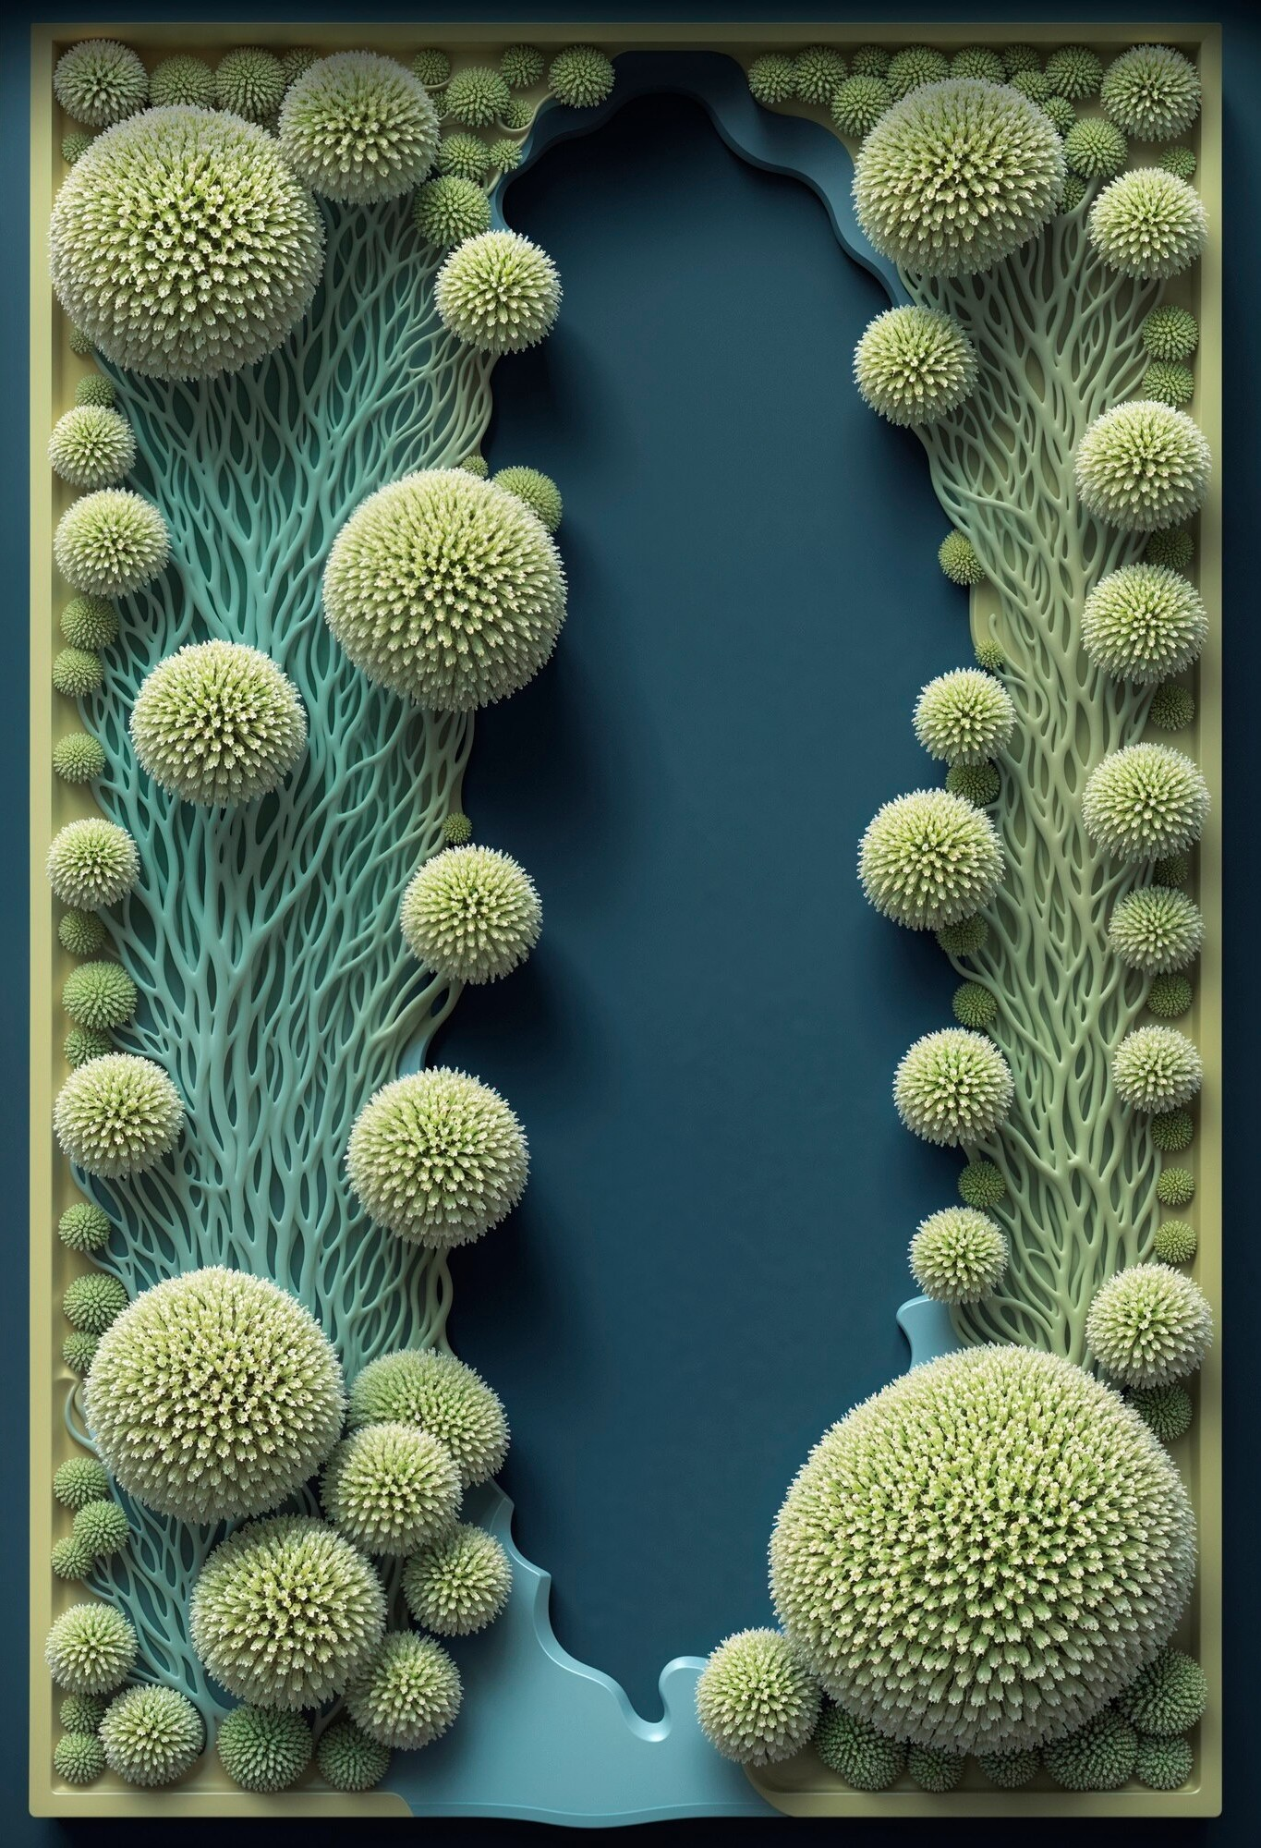
Deep Learning Advancements
Advanced algorithms can analyze intricate patterns and subtle anomalies in plant leaves
Enable precise and timely identiﬁcation of diseases
Utilizing deep learning, we can achieve accurate leaf analysis by training models to recognize disease symptoms, leaf structures, and environmental factors
Allows early detection and targeted intervention Improves crop yield and food security

Slide 5

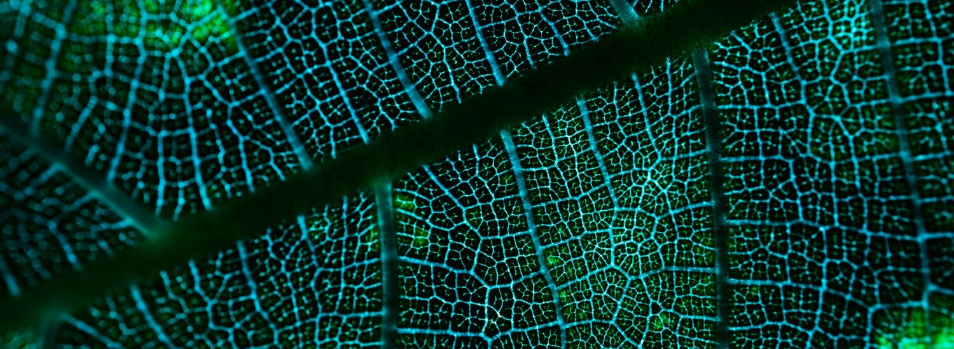
Tech Stack
End-to-end web application
ML models using Deep Learning Algorithms
Model trained using Convolutional Neural Networks (CNN)
Website developed using HTML, CSS, JavaScript and ReactJS
Backend integration using Flask API
Project deployed using Vercel and Render.
Website : https://agri-scan-ui-t9uj.vercel.app/

Slide 6

Conclusion
In conclusion, the AgriScan marks a pivotal advancement in agriculture. By harnessing the power of technology, we can enhance the resilience of crops, minimize yield loss, and contribute to global food security.

Slide 7

Thank You!
Do you have any questions?
knj1507@hotmail.com
+91 9130585267

